Slide 1
One Compartment Modeling
Biomedical Systems and Simulations
Dept. of Biomedical Engineering
Kyung Hee University

Slide 2
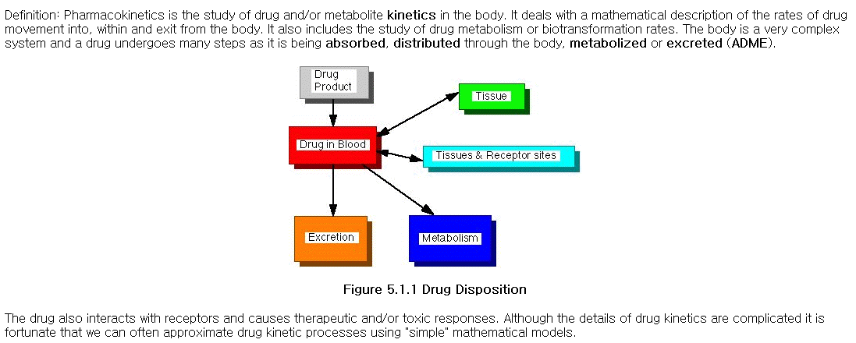
Pharmacokinetics

Slide 3
Pharmacokinetics: Mechanisms
Absorption
Distribution
Metabolism
Excretion (main topic for project)
Pharmacokinetics
Online Content for Student
https://sepia2.unil.ch/pharmacology/mechanisms/
Focus on clearance of drug
https://sepia2.unil.ch/pharmacology/parameters/clearance/

Slide 4
Pharmacokinetics: Clearance
Clearance
“Rate of drug elimination divided by plasma concentration, giving a volume of plasma from which drug is completely removed per unit of time”
https://sepia2.unil.ch/pharmacology/parameters/clearance/

Slide 5
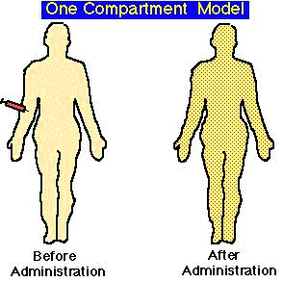
A whole human body as one compartment

Slide 6
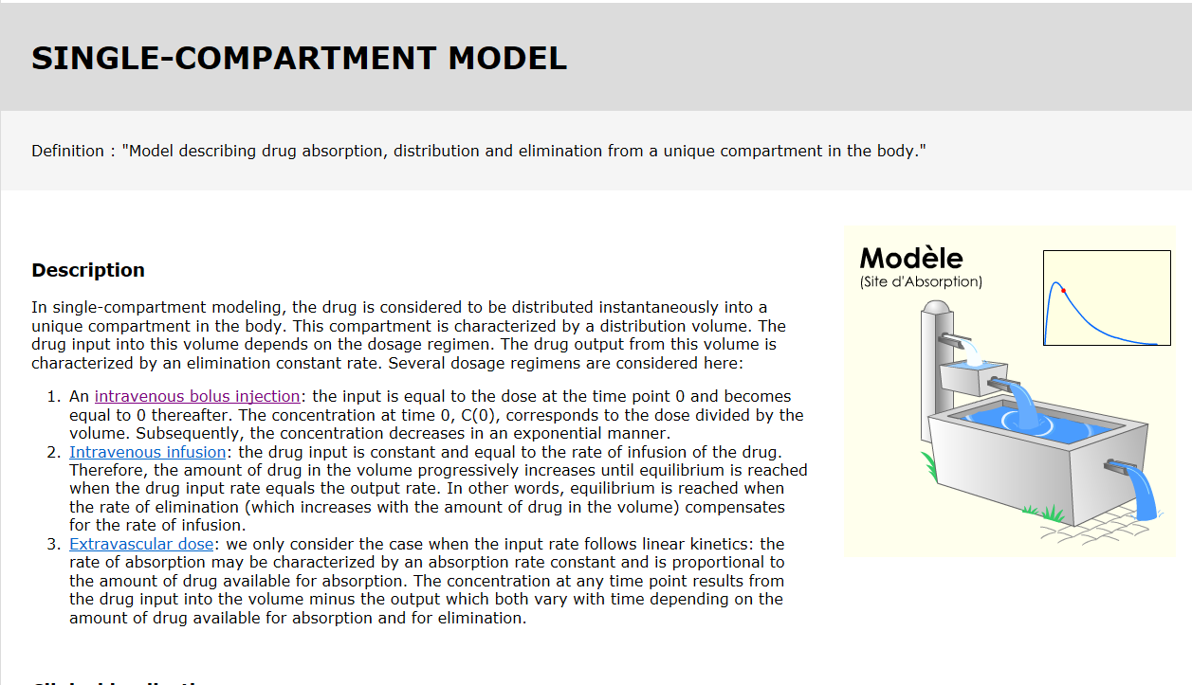
One Compartment Model

Slide 7
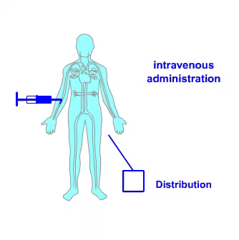
Intravenous Bolus Injection
Intravenous Bolus Injection
“Drug administration through the intravenous route over a negligible period of time”
https://sepia2.unil.ch/pharmacology/profiles/intravenous-bolus/

Slide 8
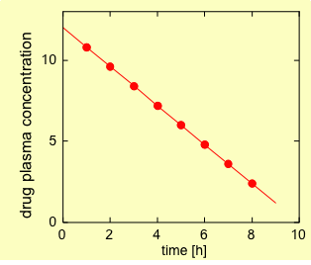
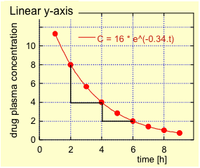
Elimination Kinetics
Elimination Kinetics
Zero-order elimination kinetics : “Elimination of a constant quantity per time unit of the drug quantity present in the organism.”
First order elimination kinetics : “Elimination of a constant fraction per time unit of the drug quantity present in the organism. The elimination is proportional to the drug concentration.”
https://sepia2.unil.ch/pharmacology/parameters/elimination-kinetics/

Slide 9
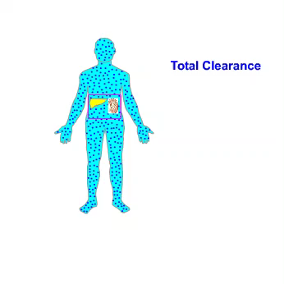
Renal Clearance
Renal Clearance
“Part of the total clearance due to renal excretion”
https://sepia2.unil.ch/pharmacology/parameters/renalclearance/

Slide 10
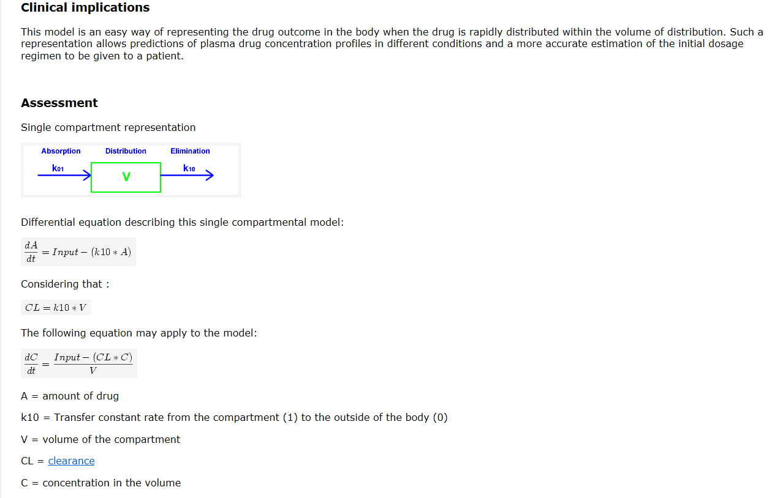
One Compartment Model

Slide 11
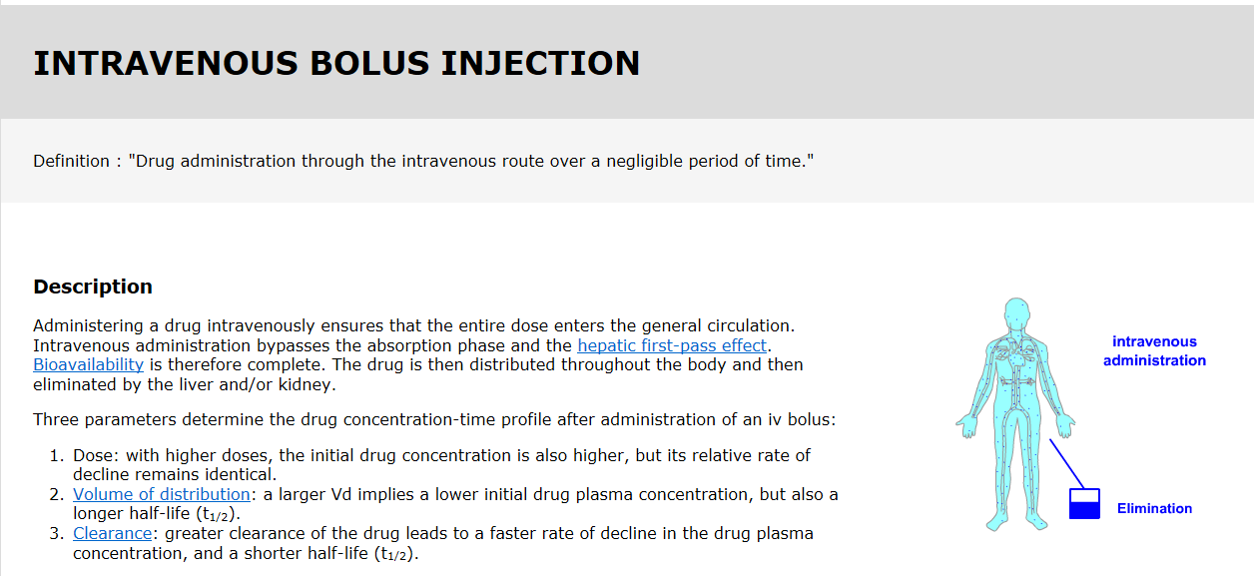
One Compartment Model

Slide 12
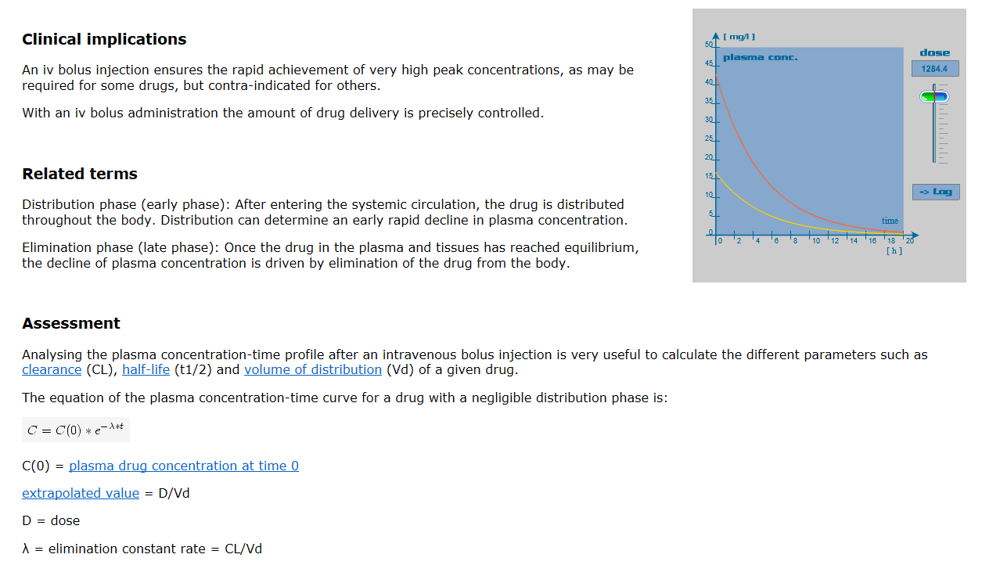
One Compartment Model

Slide 13
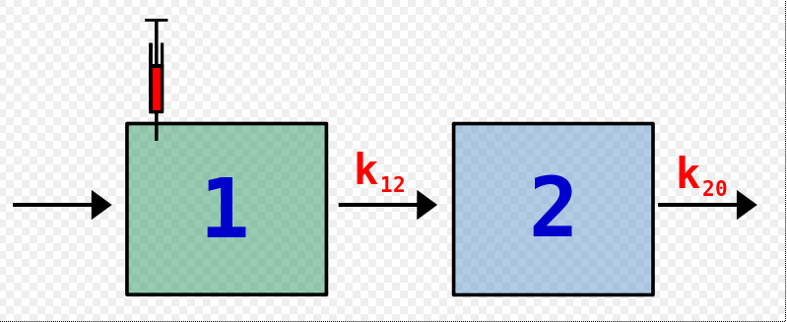
Two Compartment Model

Slide 14
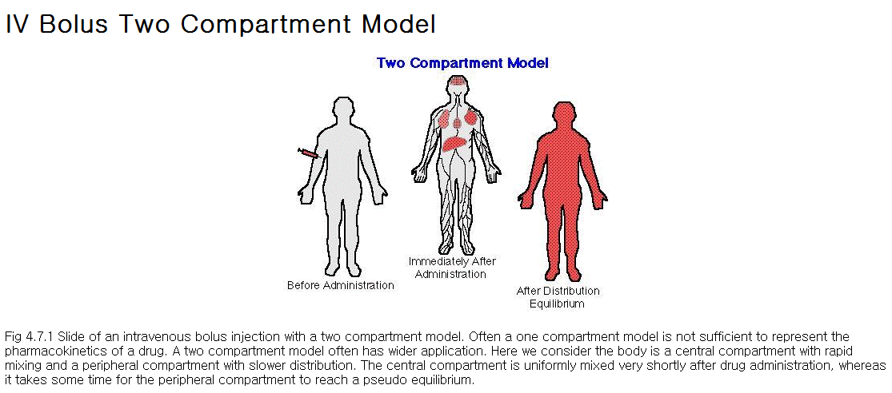
Two Compartment Model

Slide 15
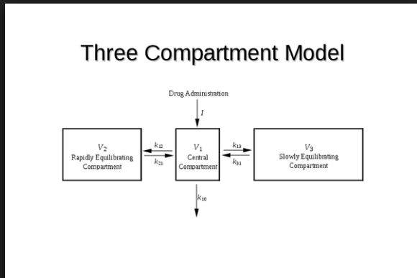
Three Compartment Model

Slide 16
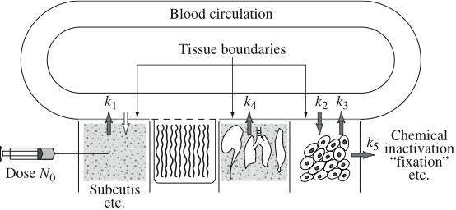
Many Compartment Model

Slide 17
Extra Info for
Compartment Modeling
Extra Materials
for Compartment Modeling
http://virtualrat.org/introduction-compartmental-modeling
Example 1: same as our project 1, a single compartment model

Slide 18
Pharmacokinetic Modeling with Matlab
Extra Info for
Compartment Modeling
Create Pharmacokinetic Models with Matlab
https://kr.mathworks.com/help/simbio/ug/creating-pharmacokinetic-models.html
One compartment model (example)
https://kr.mathworks.com/help/simbio/gs/construct-a-simple-model.html

