Slide 1
Biomedical Systems Modeling
&
Simulation:
Examples

Slide 2
Can we simulate blood flows to improve heart surgery?
https://www.youtube.com/watch?v=Y-gqQXegJvY&ab_channel=StanfordUniversitySchoolofEngineering

Slide 3
New bionics let us run, climb and dance | Hugh Herr
https://www.youtube.com/watch?v=CDsNZJTWw0w&ab_channel=TED

Slide 4
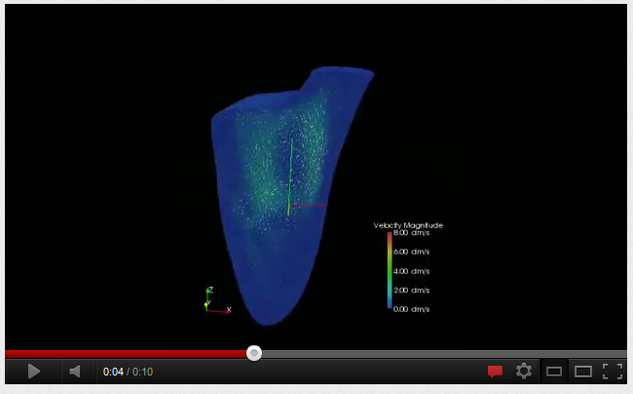
Computational Modeling of Heart Blood Flow
http://www.youtube.com/watch?v=OXMLAFIeJjc

Slide 5
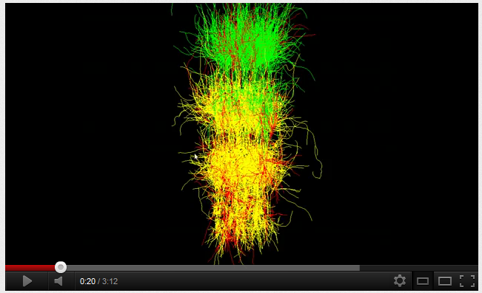
Multilayer Spiking Neural Network
http://www.youtube.com/watch?v=T2aZAWXyw6c&feature=related

Slide 6
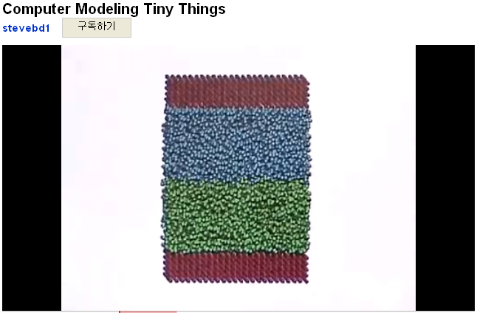
Computer Modeling Tiny Things
http://www.youtube.com/watch?v=pBEtldWb-VQ

Slide 7
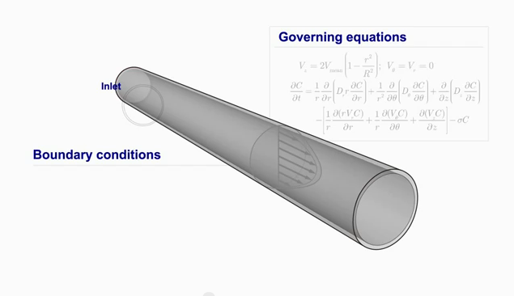
Simulating Patient-specific Nanoparticles Drug Delivery for the Treatment of Vulnerable Plaques
http://www.youtube.com/watch?v=wHQY0o8RdS4

